Slide 1
MIKROKONTROLLER 1
Arduino

Slide 2
Microcontroller
Small computer on a single integrated circuit
Nama lain
MCU (Microcontroller Unit)
SoC (System on a Chip)
MCU didesain untuk embedded application
Embedded → computer system dengan fungsi tertentu/spesifik

Slide 3
Microcontroller (2)
Memiliki CPU, memori (RAM) dan I/O
Berdasarkan Arsitektur:
CISC (Complete Instruction Set Computer)
instruksi lebih banyak, fasilitas internal secukupnya
panjang instruksi variabel (1-3 bytes)
RISC (Reduced Instruction Set Computer)
instruksi secukupnya, fasilitas internal lebih banyak, panjang instruksi tetap (2/4 bytes), mode addressing terbatas, kebanyakan instruksi dieksekusi dalam satu siklus

Slide 4
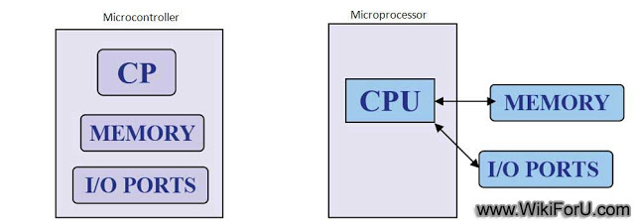
Microcontroller (3)

Slide 5
Why MCU?
Size <
Cost <
Power <
IoT (Internet of Things)

Slide 6

Internet of Things

Slide 7
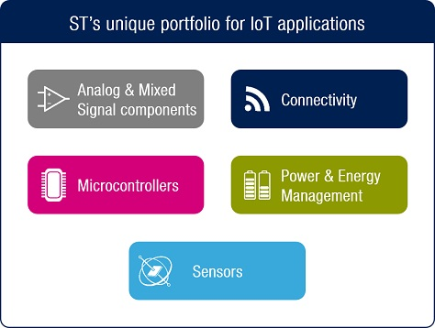
Internet of Things (2)

Slide 8
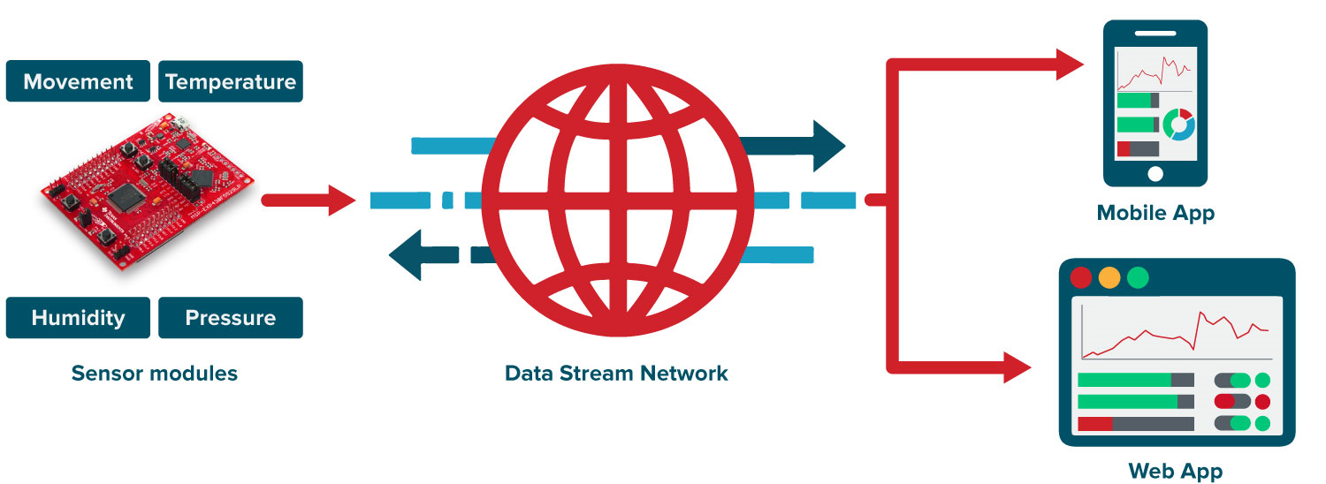
Internet of Things (3)

Slide 9
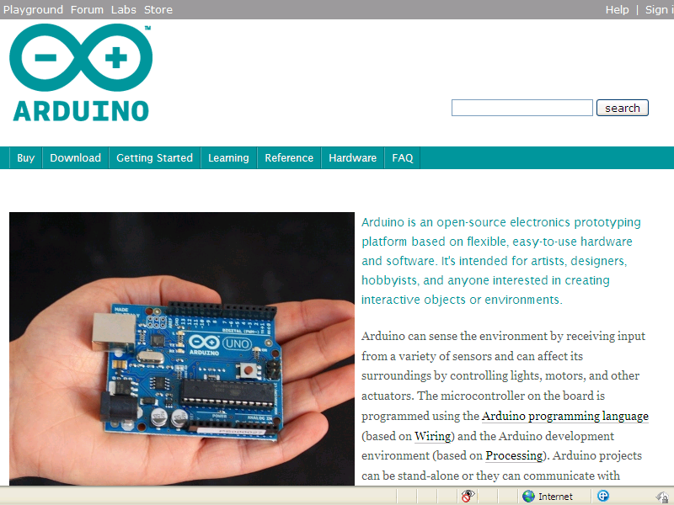
Arduino ?
http://www.arduino.cc

Slide 10
Arduino ?
Open source hardware/software prototyping platform
Physical computing: computer that can sense and control physical world compared to ordinary computer (PC)

Slide 11
Jenis Arduino
Arduino boards
Uno, Mega 2560, Mega ADK, LilyPad, Fio, Pro, Nano, Mini, Pro Mini
Arduino shields
Ethernet, Wireless SD, Wireless Proto, Motor
Arduino IDE
Kompatibel Arduino
Freeduino, Roboduino, Zigduino, dst..
Software kompatible
Boarduino, Digispark, dsb

Slide 12
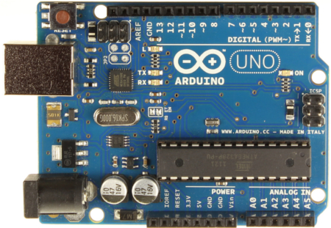
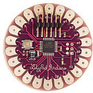
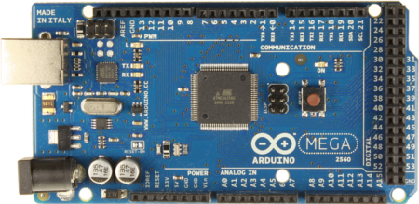
Boards

Slide 13
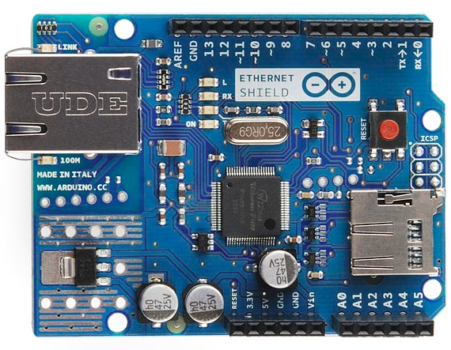
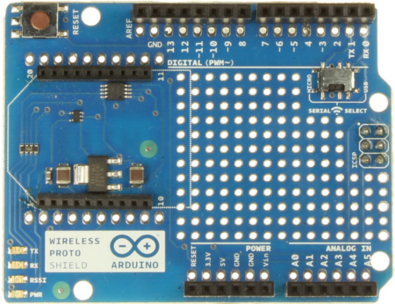
Shields

Slide 14
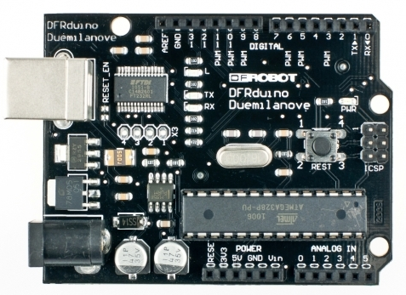
“unofficial” Boards dan Shields
Adafruit
Sparkfun
DFRobot
Itead Studio
etc

Slide 15
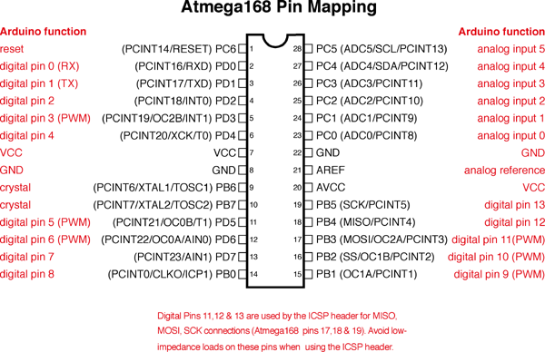
Processor

Slide 16
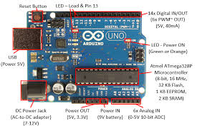
Block

Slide 17
Developer Environment
Arduino programming language berdasarkan Wiring (http://wiring.org.co)
Arduino development environment berdasarkan Processing (http://www.processing.org)
Source code = Sketches

Slide 18
Referensi Project
Taman bermain (playground)
http://arduino.cc/playground/
Reference manual
It’s already downloaded together with the Arduino IDE
http://arduino.cc/en/Reference/HomePage

